Slide 1

Foundations of Artificial Intelligence: Core Concepts and Algorithms
Welcome to an exploration of Artificial Intelligence, a field dedicated to creating systems that can reason, learn, and act with intelligence. This presentation provides an overview of the core concepts, historical approaches, and foundational algorithms essential for computer science students and early-career AI practitioners.

Slide 2






Defining Intelligence: What is AI?
Thinking Humanly
Acting Humanly
Cognitive modeling: Understanding how the human mind works to replicate it.
The Turing Test approach, focusing on behavioral equivalence.
Thinking Rationally
Laws of Thought: Using formal logic to build intelligent programs.
The AI Goal
5
Building agents that perceive the environment and take actions to maximize success.
Acting Rationally
Rational agent approach: Achieving the best expected outcome.

Slide 3

Agents and Rationality
The Rational Agent Framework
An agent is anything that can be viewed as perceiving its environment through sensors and acting upon that environment through actuators.
Agent: Takes actions based on its perceptions.
Percept Sequence: The complete history of everything the agent has ever perceived.
Rationality: An agent is rational if it chooses the action that is expected to maximize its performance measure, given the percept sequence and its built-in knowledge.
This focus on maximizing performance is key to modern AI design.

Slide 4
Specifying the Task Environment (PEAS)
To design a rational agent, we must fully specify its operating environment using the PEAS framework:
Performance Measure
Environment
Criteria for evaluating the success of the agent's behavior.
The external world the agent operates in (e.g., a dusty room, a road network).
Actuators
Sensors
The mechanisms the agent uses to affect the environment (e.g., wheels, robotic arms).
The tools used to perceive the environment (e.g., cameras, GPS, infrared sensors).
Example: For an autonomous taxi, P=Safety/Profit/Legality, E=Roads/Traffic/Pedestrians, A=Steering/Braking, S=Cameras/Lidar/Sonar.

Slide 5
Key Properties of Task Environments
Understanding the environment's properties dictates the complexity of the required agent design.
Fully vs. Partially Observable
Single vs. Multi Agent
Deterministic vs. Stochastic
Are other agents present? Cooperative or competitive?
Is the next state entirely determined by the current state and action?
Does the agent's sensors give it access to the complete state of the environment?
Episodic vs. Sequential
Discrete vs. Continuous
Are current actions independent of previous ones, or do they affect future decisions?
Does the state space, time, and performance measure take discrete or continuous values?

Slide 6

Agent Structures: From Simple to Complex
Simple Reflex
Model-Based Reflex
Goal-Based
Utility-Based
The structure of an AI agent determines how it uses its percept history and internal knowledge to select actions.
Reflex Agents: Respond directly to perceived states (fast but limited).
Model-Based Agents: Maintain an internal state of the world to handle partial observability.
Goal-Based Agents: Use goal information to choose actions that lead to a desirable state.
Utility-Based Agents: Choose actions that maximize their "utility" (preference for states) when goals conflict or multiple paths exist.

Slide 7

Problem-Solving Agents: Search Foundations
Many AI tasks can be framed as search problems, where the agent needs to find a sequence of actions that leads from the initial state to a goal state.
Well-Defined Problem Components
Solution
Initial state
A sequence of actions leading from the initial state to a goal state.
Action set (successor function)
Goal test
Finding the optimal solution often involves searching through the state space tree.
Path cost function

Slide 8
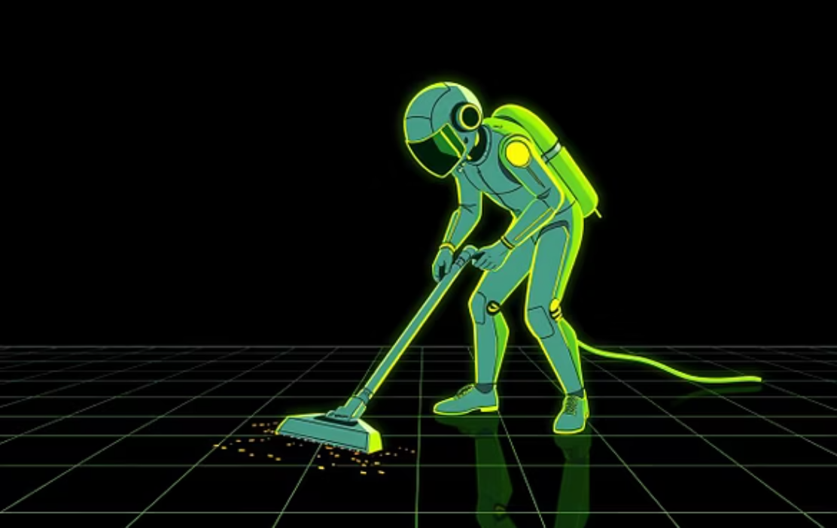

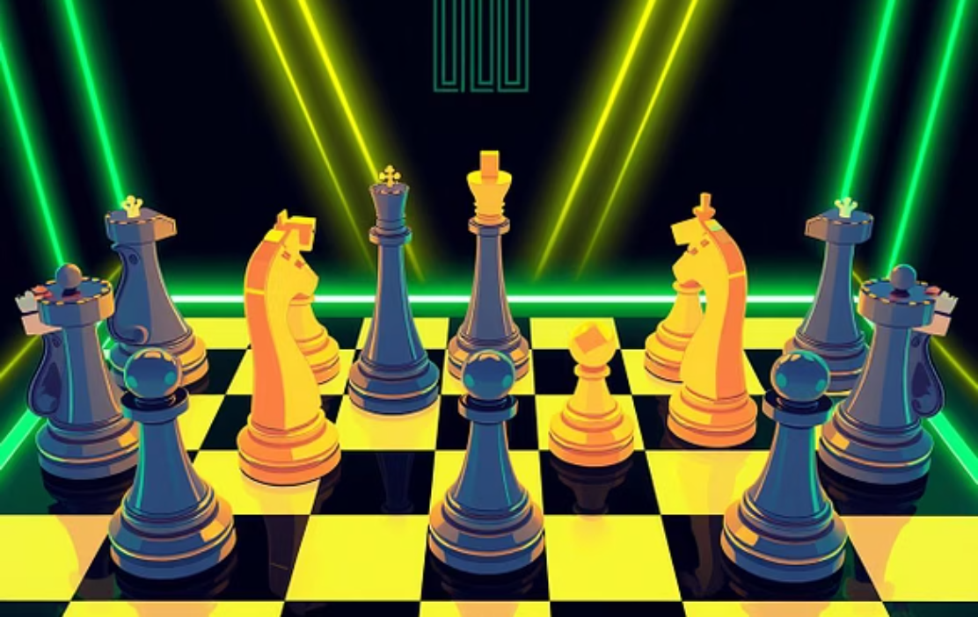
Illustrative Search Problems
These "toy problems" are used to test and compare the performance of various search algorithms:
Vacuum World
8-Puzzle (Tile Sliding)
8 Queens Problem
Simple environment to illustrate basic reflex and goal-based behavior in a discrete, deterministic setting.
A classic testbed for search algorithms; often used to compare the efficiency of heuristic search methods.
A constraint satisfaction problem solved via search, where eight queens must be placed on a chessboard without attacking each other.

Slide 9
Search Strategies: Uninformed & Informed
Search strategies are categorized based on whether they use problem-specific knowledge (heuristics) to guide the search.
Uninformed Search (Blind)
Informed Search (Heuristic)
Explores the state space without any extra information about the goal location.
Uses an evaluation function to estimate the cost from the current state to the goal.
Breadth-First Search (BFS)
Greedy Best-First Search
Depth-First Search (DFS)
A* Algorithm (Optimal and complete)
Depth-Limited Search (DLS)
Hill-Climbing Search
Iterative Deepening Search (IDS)
Local Beam Search
Bidirectional Search
AND-OR Search

Slide 10



Adversarial Search and Constraint Satisfaction
These advanced techniques handle situations involving competition or complex logical constraints.
Minimax Algorithm
Used in two-player, zero-sum games (like Chess). Assumes the opponent is perfectly rational and seeks to minimize the agent's outcome.
Alpha-Beta Pruning
An optimization for Minimax that eliminates branches of the search tree that are guaranteed not to lead to a better move, significantly increasing speed.
Constraint Satisfaction Problems (CSPs)
Defined by variables, domains, and constraints. Solved using specialized search techniques (e.g., Cryptarithmetic Puzzles).
Heuristics in CSP
Techniques like Local Consistency, Backtracking, Minimum Remaining Value (MRV), and Degree Heuristic optimize the search for a consistent solution.

